Slide 1
TherMOS: A Thermal Model for
Self-heating in Advanced MOSFETs
Vidya A. Chhabria, Arvind K. Sharma, Meghna G. Makalale and Sachin S. Sapatnekar
University of Minnesota
November 2019
1

Slide 2
Outline
Introduction
Self-heating at the device level
TherMOS: A self-heating temperature analyzer
TherMOS: Results and use case
Conclusion
2

Slide 3
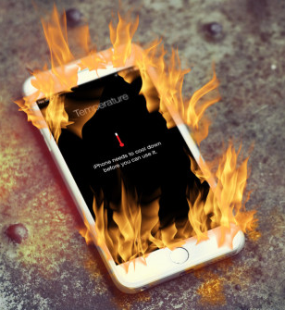
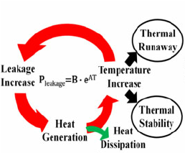
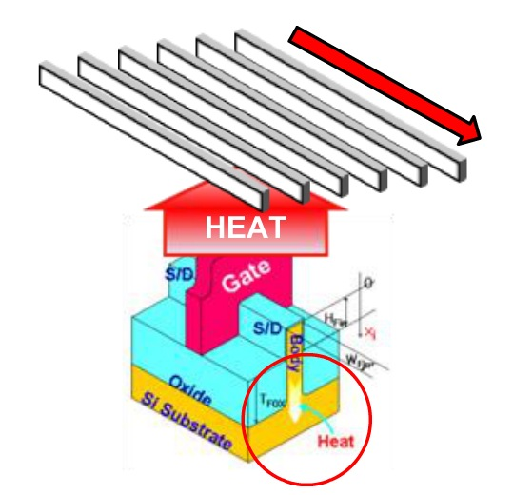

Introduction
Planar MOSFETs:
> 20nm node
> 20nm node
3D multigate FETs:
SOI FinFET
Lateral GAAFET
16/14nm node
< 5nm node
2
Notes:
Beyond the 20nm node, the small device dimensions have made it difficult for the gate to control the channel of the planar MOSFET.
To enable efficient scaling, modern devices are based on multigate 3D architectures that provide improved electrostatic control. These devices help reduce SCE, increase the drive current per unit footprint, and lower the supply voltage.
The superior scalability provided by the confined 3D architectures of modern devices, comes at the cost of increased self-heating.
Given the exponential thermal dependence of reliability and leakage, we need to accurately measure the SH and predict the impact it has on circuit performance and various aging related phenomenons such as bias temperature instability (BTI), hot carrier injection (HCI), and electromigration (EM).
Our work builds an accurate finite difference based thermal model for circuits built using FinFETs and GAAFETs. The model provides precise estimates of the device temperature by accounting for intricate details at the device level and gate level. And further we study the impact SH has on circuit level performance and reliability.

Slide 4
TherMOS: Self-heating at the Device Level
BOX layer has low thermal conductivity
Boundary scattering reduces thermal conductivity of the fin
1um
V. A. Chhabria, et al., ISQED 2019
3
Notes:
A more interesting temperature profile is shown on the next slide. This is a cross-section view with the detail temperature contours. This shows the bulk FinFET, and a detailed temperature contour plot for this device from the FDM simulation. There is a direct path to the substrate, however, the surface area is small because of the thin fin. There in an increase in temperature. For the same amount of power dissipation, this rise in temperature in smaller when compared to SOI FinFETS where the box layer makes heat flow towards the substrate difficult, most of the heat flows through the fin. A very similar profile is observed in GAAFET that are also surrounded by oxide on all sides, except the NWs here are located on top have higher temperatures since they have a more resistive equivalent path to thermal ground when compared to the lower NWs.

Slide 5
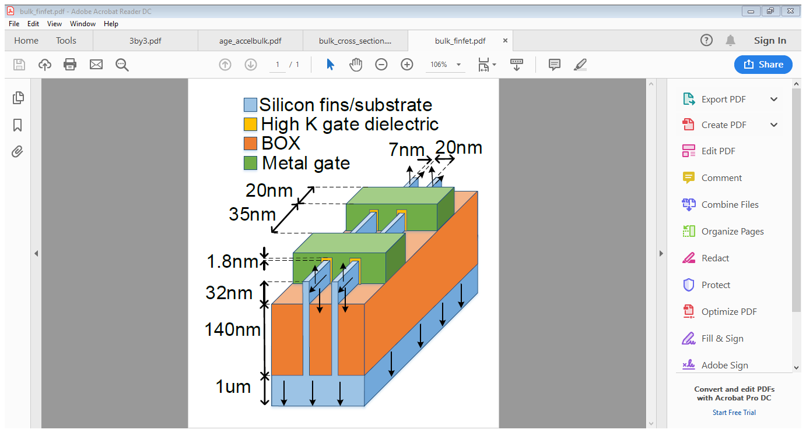
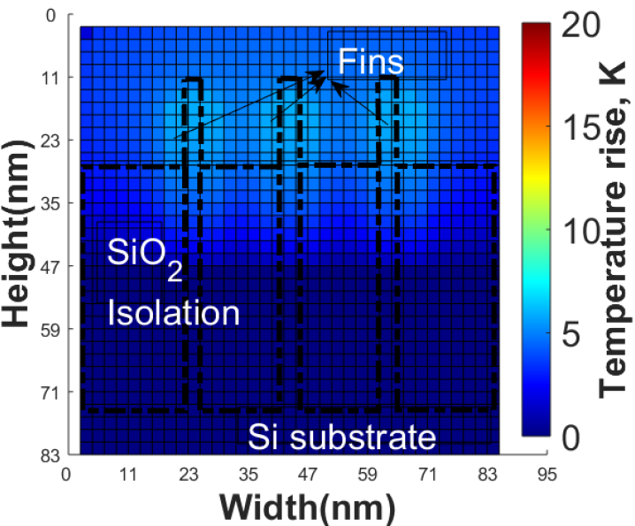
TherMOS: Self-heating at the Device Level
BOX layer has low thermal conductivity
Boundary scattering reduces thermal conductivity of the fin
1um
1um
V. A. Chhabria, et al., ISQED 2019
4
Notes:
A more interesting temperature profile is shown on the next slide. This is a cross-section view with the detail temperature contours. This shows the bulk FinFET, and a detailed temperature contour plot for this device from the FDM simulation. There is a direct path to the substrate, however, the surface area is small because of the thin fin. There in an increase in temperature. For the same amount of power dissipation, this rise in temperature in smaller when compared to SOI FinFETS where the box layer makes heat flow towards the substrate difficult, most of the heat flows through the fin. A very similar profile is observed in GAAFET that are also surrounded by oxide on all sides, except the NWs here are located on top have higher temperatures since they have a more resistive equivalent path to thermal ground when compared to the lower NWs.

Slide 6
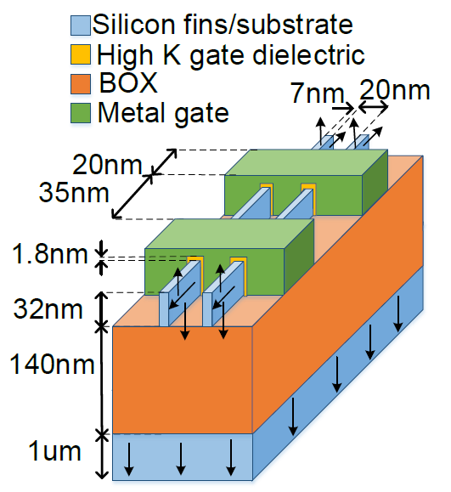
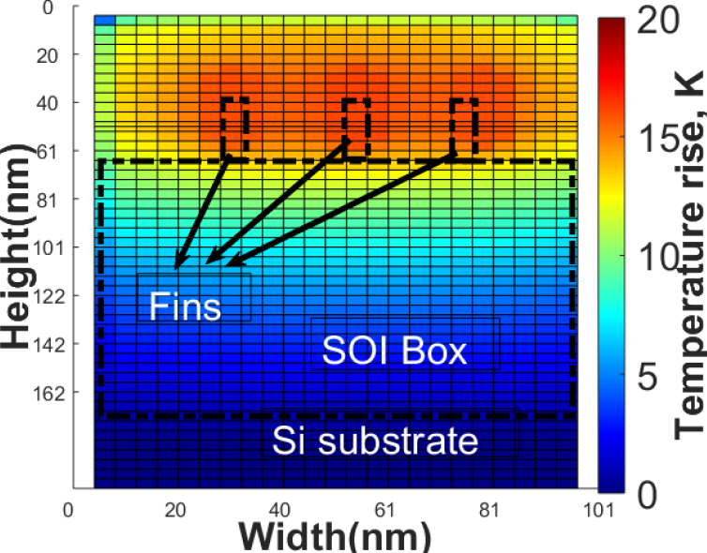
TherMOS: Self-heating at the Device Level
BOX layer has low thermal conductivity
Boundary scattering reduces thermal conductivity of the fin
1um
1um
1um
V. A. Chhabria, et al., ISQED 2019
5
Notes:
A more interesting temperature profile is shown on the next slide. This is a cross-section view with the detail temperature contours. This shows the bulk FinFET, and a detailed temperature contour plot for this device from the FDM simulation. There is a direct path to the substrate, however, the surface area is small because of the thin fin. There in an increase in temperature. For the same amount of power dissipation, this rise in temperature in smaller when compared to SOI FinFETS where the box layer makes heat flow towards the substrate difficult, most of the heat flows through the fin. A very similar profile is observed in GAAFET that are also surrounded by oxide on all sides, except the NWs here are located on top have higher temperatures since they have a more resistive equivalent path to thermal ground when compared to the lower NWs.

Slide 7
Outline
Introduction
Self-heating at the device level
TherMOS: A self-heating temperature analyzer
TherMOS: Results and use case
Conclusion
6

Slide 8
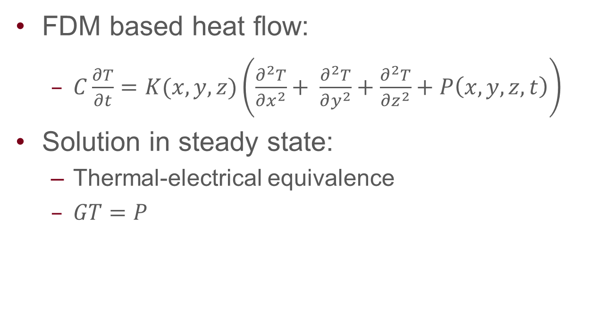
Finite Difference Method (FDM) Modeling
FDM based heat flow:
  $C\frac{∂T}{∂t}=K(x,y,z)\left(\frac{∂^{2}T}{∂x^{2}}+ \frac{∂^{2}T}{∂y^{2}}+\frac{∂^{2}T}{∂z^{2}}+P\left(x,y,z,t\right)\right)$
Solution in steady state:
  Thermal-electrical equivalence
  $GT=P$
Y. Zhan, et al., Found. Trends Electron. Des. Autom. 2008
7
Notes:
The heat flow equation is governed by the partial differential equation shown on the screen where,
Using the finite difference method to solve the above the equation in steady state, thermal-electrical equivalence shows that, the solutions can be represented a s asytem of linear equations given by GT=P,
The larger the number of finite elements the more accurately we can estimate temperature. In our case, since we are looking at this at a device level, we use a fine-grained mesh to estimate this temperature rise due to self-heating.
It should be noted here that fin/NW is a thin film of Si. The elctron in this film experience boundary scattering. They collide with with the phonons, phonons are just lattice vibration, mobility reduction which reduces mean free path of the carriers. Since mean free path is proportional to conductivity there is a reunion in thermal conductivity at these small dimensions. Therefore, we use these scaled versions of thermal conductivity in the above G matrix.
The values in vector P, are based on the power generated by the devive that is distributred within each element inside the channel based on the graph as shown in the top corner.
Now that we have G, and P we can solve for the vector of unknown T to obtain a temperature profile as shown in the bottom right corner. This is the top view of the SOI FinFET, showing hheat dissipation along the fin.

Slide 9
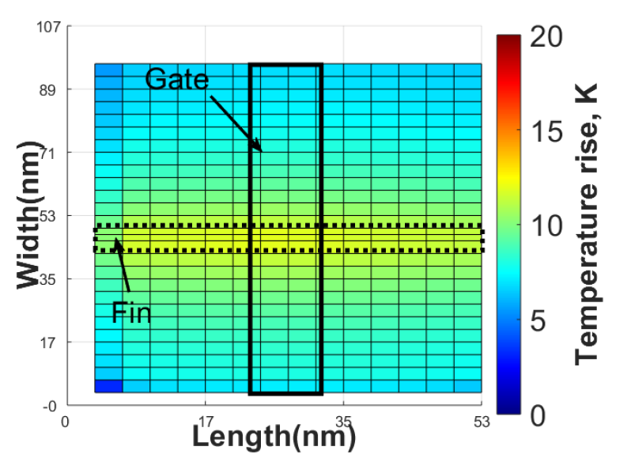

Finite Difference Method (FDM) Modeling
FDM based heat flow:
  $C\frac{∂T}{∂t}=K(x,y,z)\left(\frac{∂^{2}T}{∂x^{2}}+ \frac{∂^{2}T}{∂y^{2}}+\frac{∂^{2}T}{∂z^{2}}+P\left(x,y,z,t\right)\right)$
Solution in steady state:
  Thermal-electrical equivalence
  $GT=P$
$$H=\vec{J}.\vec{E}$$
Heat generation rate (W/cm³)
Distance along channel
(channel length units)
E.Pop, et al., IEDM 2003
Y. Zhan, et al., Found. Trends Electron. Des. Autom. 2008
8
Notes:
The heat flow equation is governed by the partial differential equation shown on the screen where,
Using the finite difference method to solve the above the equation in steady state, thermal-electrical equivalence shows that, the solutions can be represented a s asytem of linear equations given by GT=P,
The larger the number of finite elements the more accurately we can estimate temperature. In our case, since we are looking at this at a device level, we use a fine-grained mesh to estimate this temperature rise due to self-heating.
It should be noted here that fin/NW is a thin film of Si. The elctron in this film experience boundary scattering. They collide with with the phonons, phonons are just lattice vibration, mobility reduction which reduces mean free path of the carriers. Since mean free path is proportional to conductivity there is a reunion in thermal conductivity at these small dimensions. Therefore, we use these scaled versions of thermal conductivity in the above G matrix.
The values in vector P, are based on the power generated by the devive that is distributred within each element inside the channel based on the graph as shown in the top corner.
Now that we have G, and P we can solve for the vector of unknown T to obtain a temperature profile as shown in the bottom right corner. This is the top view of the SOI FinFET, showing hheat dissipation along the fin.

Slide 10

WAIT BUT WHY TherMOS??
9
Notes:
The heat flow equation is governed by the partial differential equation shown on the screen where,
Using the finite difference method to solve the above the equation in steady state, thermal-electrical equivalence shows that, the solutions can be represented a s asytem of linear equations given by GT=P,
The larger the number of finite elements the more accurately we can estimate temperature. In our case, since we are looking at this at a device level, we use a fine-grained mesh to estimate this temperature rise due to self-heating.
It should be noted here that fin/NW is a thin film of Si. The elctron in this film experience boundary scattering. They collide with with the phonons, phonons are just lattice vibration, mobility reduction which reduces mean free path of the carriers. Since mean free path is proportional to conductivity there is a reunion in thermal conductivity at these small dimensions. Therefore, we use these scaled versions of thermal conductivity in the above G matrix.
The values in vector P, are based on the power generated by the devive that is distributred within each element inside the channel based on the graph as shown in the top corner.
Now that we have G, and P we can solve for the vector of unknown T to obtain a temperature profile as shown in the bottom right corner. This is the top view of the SOI FinFET, showing hheat dissipation along the fin.

Slide 11
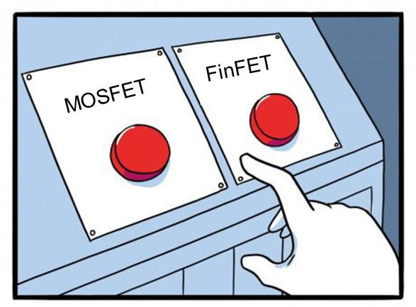
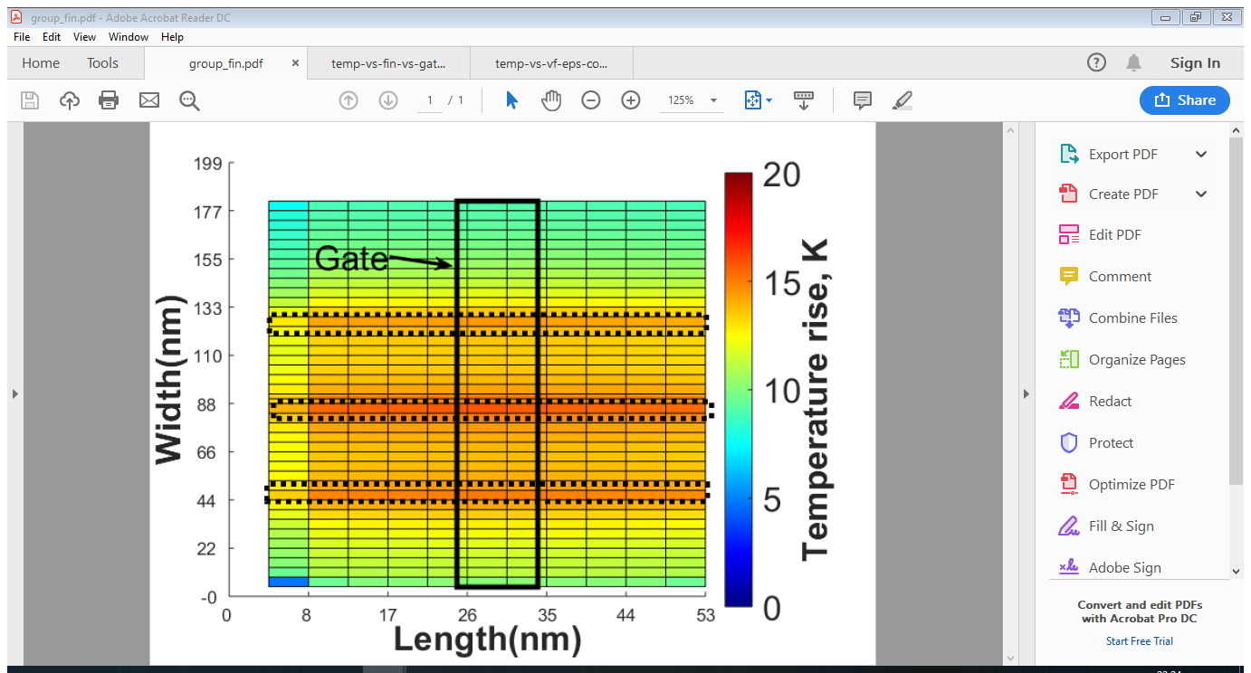
Why TherMOS?
Easy to use
Fast multifin and multigate simulation
10

Slide 12
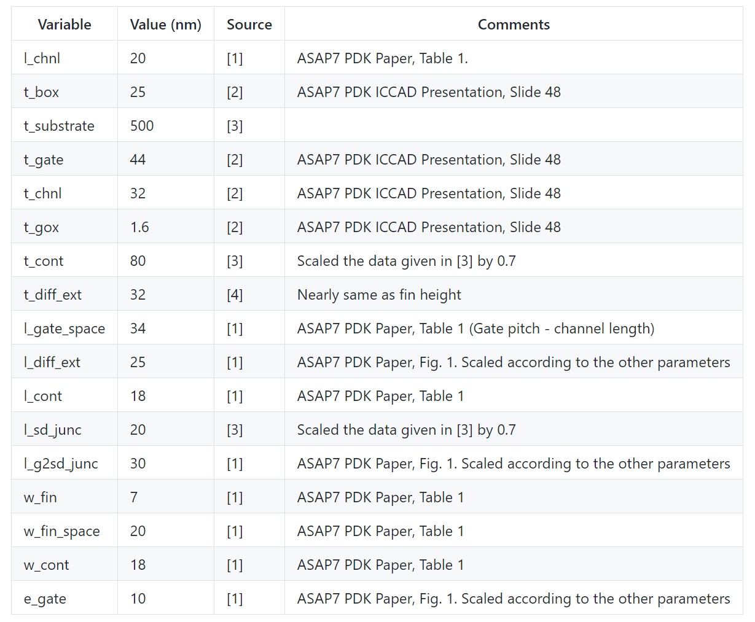
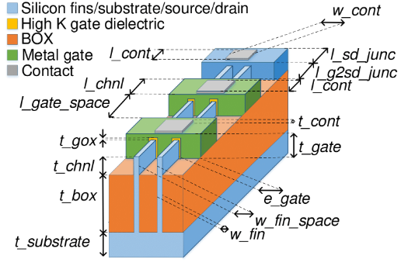

Why TherMOS?
[1] L. T. Clark, et al., Microelec. Journal 2016
[2] V. Vashishtha, et al., ICCAD Embedded Tutorial, 2017
[3] M. Shrivastava, et al., IEEE Trans. Elec. Devices, 2012
[4] B. Swahn , et al., IEEE Trans. VLSI Systems, 2008
11

Slide 13
Outline
Introduction
Self-heating at the device level
TherMOS: A self-heating temperature analyzer
TherMOS: Results and use case
Conclusion
12

Slide 14


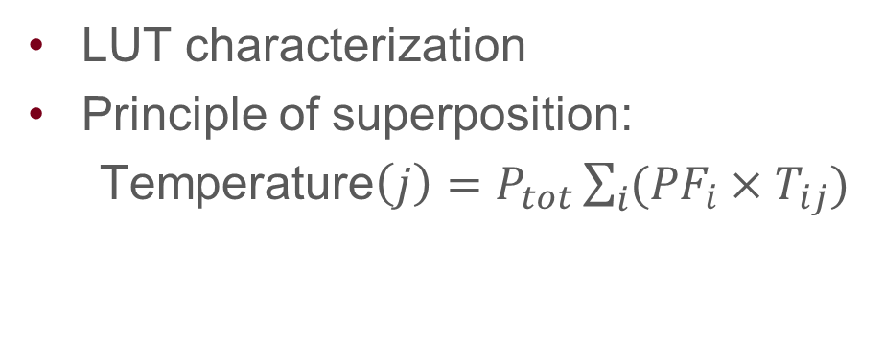







TherMOS Use Case: At a Circuit-level
LUT characterization
Principle of superposition:
  Temperature$\left(j\right)=P_{tot}\sum_{i}{({PF}_{i}×T_{ij})}$
Contact
Local interconnect
Gate terminal
Fins
$$I_{1}$$
$$I_{2}$$
$$I_{3}$$
$$I_{4}$$
Metal
$$I_{1}$$
$$I_{2}$$
$$I_{3}$$
$$I_{4}$$
$$Y$$
V. A. Chhabria, et al., ISQED 2019
14
Notes:
To find the temperature of the logic gate, we sum up the contribution to the increase in temperature from every gate terminal in the array as per the equation is shows on the screen where Ptot = alphaCvvd2f is the total power dissipation of the logic gate/standard cell. PFi is the fraction of power dissipated in that input. The power factor depends on the probability of that transistor switching. The details of how this is obtained is within the paper and for the sake of time, will be skipped over for now.

Slide 15
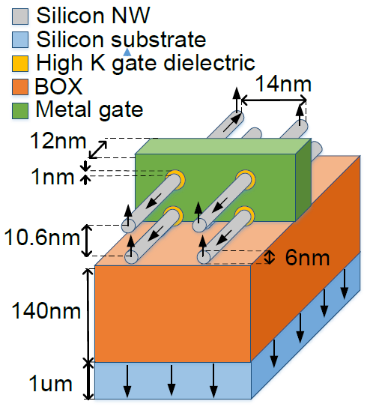
TherMOS Use Case: At a Circuit-level
Bulk FinFET
SOI FinFET
GAAFET
V. A. Chhabria, et al., ISQED 2019
15
Notes:
Now that we have an understanding of the characterization of self-heating at the device and gate level, we move on to analyzing the impact it has at the circuit level.
We leverage a STA tool to enable activity factor propagation, and output load estimation for every logic gate. Based on the size of the logic gate and its configurations, of transistors either series, parallel, or a combination we use the precharacterized LUT to obtain the temperature of the gate.
The graph here shows

Slide 16
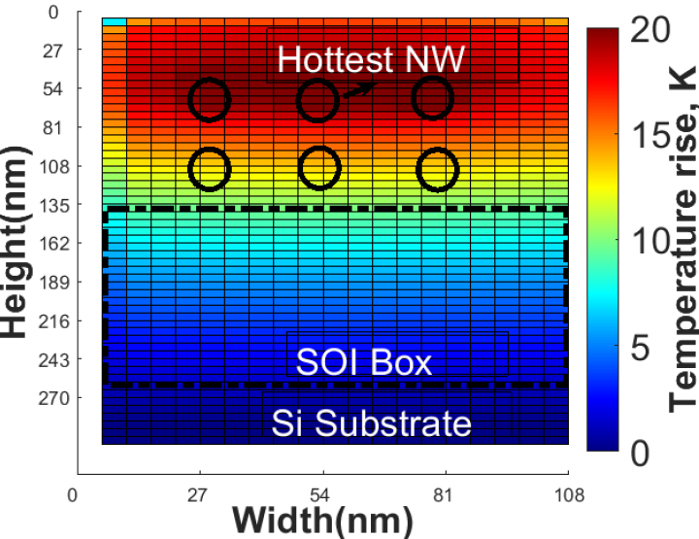
TherMOS Use Case: Reliability Analysis
BTI and HCI have exponential dependence on temperature
Bulk FinFET
SOI FinFET
GAAFET
V. A. Chhabria, et al., ISQED 2019
16
Notes:
BTI and HCI are reliability mechanisms that reduce the lifetime of circuits. These phenomena are typically modeled by a degradation in the threshold voltage overtime and have an exponential dependence on temperature. In this figure, these exponential degradations is captured by the degradation in the 10-year circuit delay of these benchmarks. It can be seen here that the with HCI has a smaller time exponent for both FinFETs and SOI based GAAFTe devices when compared oth their bulk counterpart. Hence hCI is dominated by BTi in these technologies BTi folllws the regular trend, since temperature of SOI FinFET and GAAFET is more thn that of bulk they have a greter BTi degradation.

Slide 17
Conclusion
Modern FDSOI and multigate devices suffer from SH
TherMOS analyzes the rise in temperature
17

Slide 18

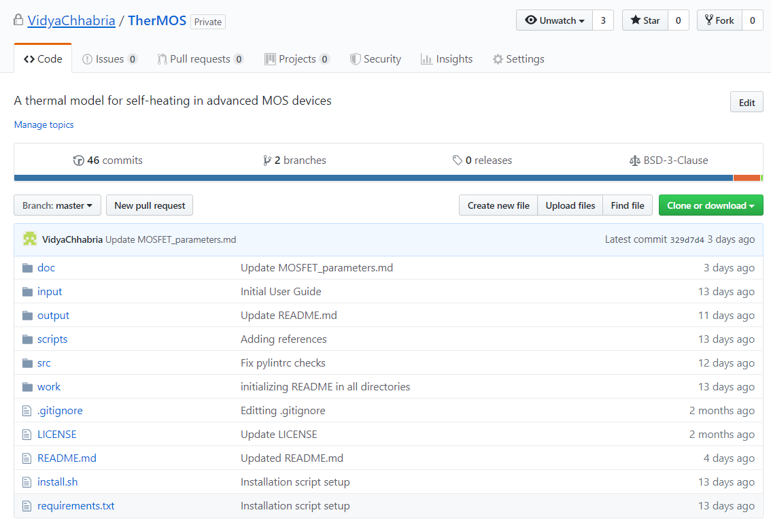
Conclusion
Modern FDSOI and multigate devices suffer from SH
TherMOS analyzes the rise in temperature
Give it a whirl:
  https://github.com/VidyaChhabria/TherMOS
  git clone; source install.sh; pytest
  python3 SOI_FinFET –device_type NMOS
  –n_fin 3 –n_gate 1 –power 5e-6
Thank you! Questions?
19

Slide 19
BACKUP SLIDES

Slide 20
TherMOS Results: Temperature Contour Plots
1um
1um
V. A. Chhabria, et al., ISQED 2019
19
Notes:
A more interesting temperature profile is shown on the next slide. This is a cross-section view with the detail temperature contours. This shows the bulk FinFET, and a detailed temperature contour plot for this device from the FDM simulation. There is a direct path to the substrate, however, the surface area is small because of the thin fin. There in an increase in temperature. For the same amount of power dissipation, this rise in temperature in smaller when compared to SOI FinFETS where the box layer makes heat flow towards the substrate difficult, most of the heat flows through the fin. A very similar profile is observed in GAAFET that are also surrounded by oxide on all sides, except the NWs here are located on top have higher temperatures since they have a more resistive equivalent path to thermal ground when compared to the lower NWs.

Slide 21

Why TherMOS?
Fast run-times: User-definable resolution and non-uniform meshing
14

Slide 22
Why TherMOS?
Fast run-times: User-definable resolution and non-uniform meshing
Device parameters compiled from literature sources for 7FF and 14nm FDSOI technologies
15

Slide 23
Why TherMOS?
Fast run-times: User-definable resolution and non-uniform meshing
Device parameters compiled from literature sources for 7FF and 14nm FDSOI technologies
Multifin and multigate array simulation
16

Slide 24
Why TherMOS?
Fast run-times: User-definable resolution and non-uniform meshing
Device parameters compiled from literature sources for 7FF and 14nm FDSOI technologies
Multifin and multigate array simulation
Detailed model for power distributions
Submicron boundary scattering effects
Heat generation rate (W/cm³)
Distance along channel
(channel length units)
17

Slide 25
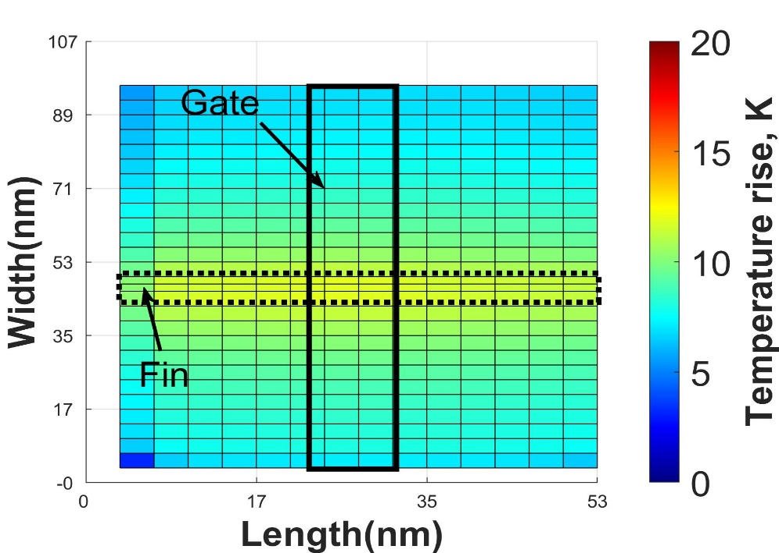








Contact Location and Size of Array
Contacts act as a path to thermal ground
Contact
Local interconnect
Gate terminal
$$I_{1}$$
$$I_{2}$$
$$I_{3}$$
$$I_{4}$$
Fins
Metal
$$I_{1}$$
$$I_{2}$$
$$I_{3}$$
$$I_{4}$$
8
Notes:
In this way, we characterize the temperature at the gate level. We now move on to certain parameters that actually impact the temperature.

Slide 26
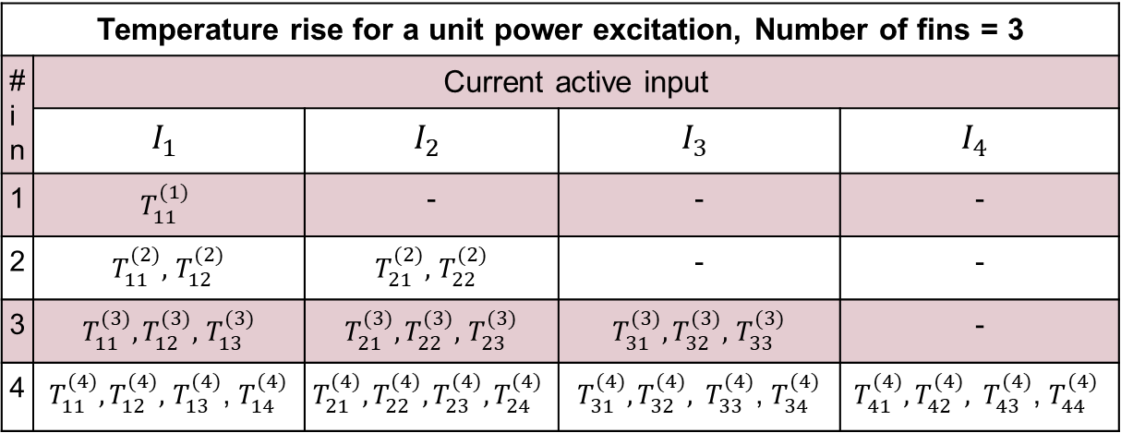




Look-up-table (LUT) Characterization
Local interconnect
Metal
Temperature rise for a unit power excitation, Number of fins = 3
# in | Current active input
 | $$I_{1}$$ | $$I_{2}$$ | $$I_{3}$$ | $$I_{4}$$
1 | $$T_{11}^{(1)}$$ | - | - | -
2 | $T_{11}^{(2)},$ $T_{12}^{(2)}$ | $T_{21}^{(2)},$ $T_{22}^{(2)}$ | - | -
3 | $T_{11}^{(3)},T_{12}^{(3)},$ $T_{13}^{(3)}$ | $T_{21}^{(3)},T_{22}^{(3)},$ $T_{23}^{(3)}$ | $T_{31}^{(3)},T_{32}^{(3)},$ $T_{33}^{(3)}$ | -
4 | $T_{11}^{(4)},T_{12}^{(4)},$ $T_{13}^{(4)}$, $T_{14}^{(4)}$ | $$T_{21}^{(4)},T_{22}^{(4)},T_{23}^{(4)},T_{24}^{(4)}$$ | $T_{31}^{(4)},T_{32}^{(4)}, T_{33}^{(4)}$, $T_{34}^{(4)}$ | $$T_{41}^{(4)},T_{42}^{(4)}, T_{43}^{(4)}\text{, }T_{44}^{(4)}$$
$$I_{1}$$
$$I_{2}$$
$$I_{3}$$
$$I_{4}$$
Fin
Contact
Gate terminal
7
Notes:
How characterization of SH is done the gate level. The layout on the left shows 4 transistors connected in a parallel configuration. With 3 fins and 4 gate terminals. This can be considered to be a PUN of a 4 input NAND gate for example.
The temperature rise in one transistors impacts the temperature in the other transistors even if they are OFF. The GT=P is a linear system and we leverage the principle of superposition to estimate the impact of power dissipation in one transistor on the others in the array. We characterize various such scenarios for different sizes of cells are store the temperatures in LUTs. Why LUT? Since each FDM solution is computationally expensive. . Performing such a simulation at the circuit level for each cell is not feasible for every gate in the circuit. Therefore, we pre characterize two LUTs one for the parallel configuration and another for the series configuration and for cells of different sizes. A unit power dissipation is applied at each input and the temperature rise is estimated for each trasnsitor in the array. The LUT of the layout shown on the right. The y direction is the current active input or the input to which a unit power dissipation is applied and x direction is the total number of gate terminals in the array, where T11 is the temperature in I1 due to unit power dissipated in I1, and T12 is the temperature rise in I2 due to a unit power dissipation in I1.

Slide 27
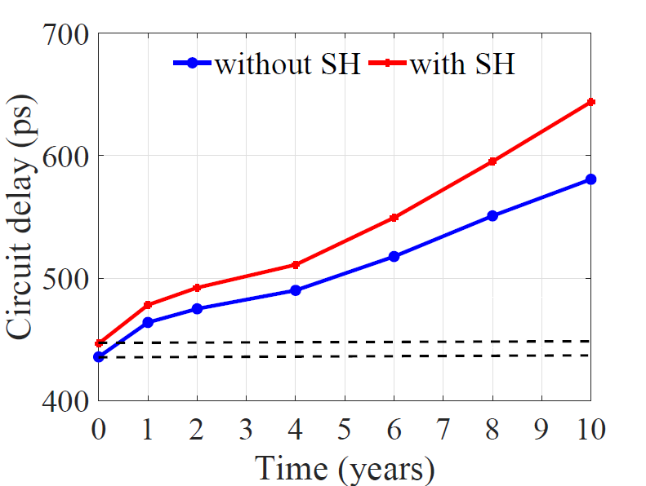

Conclusion
3-D multigate devices suffer from increased SH
Thermal model:
  FDM model at the device level
  Superposition + LUT characterization
Aging is accelerated
EM : $∆T=4K$ →15% degradation in time to failure
Self-heating Effects
 | Bulk FinFET | SOI FinFET | GAAFET
Average rise in temperature in a logic gate | 5K | 12K | 18K
% Aging acceleration (BTI + HCI) | 28 | 37 | 39
% Degradation in time to failure (EM) | 14 | 38 | 45
17

Slide 28
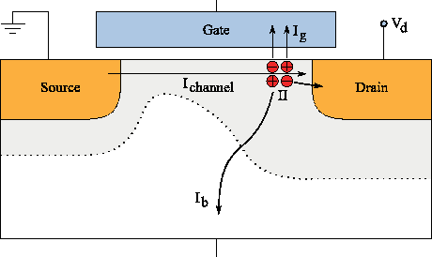
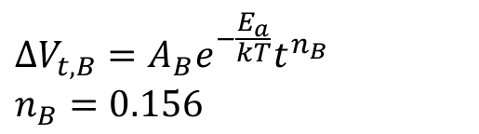
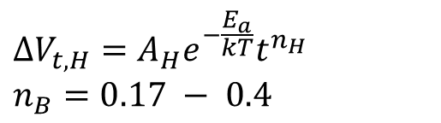
Reliability Issues
Bias temperature instability (BTI)
SiH + h⁺ → Si⁺ + ½H₂
Si
H
$$∆V_{t,B}=A_{B}e^{−\frac{E_{a}}{kT}}t^{n_{B}}$$
$$n_{B}=0.156$$
Si
H
H₂
Si
H
Substrate
Gate Oxide
Poly
Hot carrier injection (HCI)
$$∆V_{t,H}=A_{H}e^{−\frac{E_{a}}{kT}}t^{n_{H}}$$
$$n_{B}=0.17 − 0.4$$
HCI in GAAFET is negligible
R. Wang, et al., IEDM 2007
14

Slide 29
Impact of SH on Electromigration (EM)
EM has an exponential dependence on temperature
Bulk FinFET
SOI FinFET
GAAFET
16
Notes:
Electromigration is the transfer of material atoms caused by momentum transfer of the conducting electrons. This phenomenon also has an exponential dependence with temperature. Since the SOI and modern technologies have a lot of heat dissipation via the contacts towards the metal wires, the nearby metal wires heat up, and are victims of EM. Moreover, power the supply grids have a unidirectional flow in current and if they heat up are more susceptible to EM. In the figure shown here we measure the degradation in the lifetime of these wires due to SH. Again similar trends follow as BTI where technologies with higher temperature have a lower lifetime.

Slide 30
Circuit-level Impact of SH on BTI and HCI
At t=0, the degradation in delay is due to self-heating alone
Aging is accelerated due to SH causing a reduction in circuit lifetime
Bulk FinFET
SOI FinFET
GAAFET
Delay degradation of the ITC’99 b20 benchmark with time
19
Notes:
We will now just consider one circuit and observe the degradation in circuit delay due to SH for all the three technologies over a period of .time Basically observer how aging (both BTi and HCI) is accelerated over time due to elevated device temperatures. This is for a bulk FinFET device. The blue line is the circuit delay at elevated temperatures by taking SH into account, and the blue line is without measuring self-heating. The slope of the red line is larger than that of the blue line. At the time t=0, there the delay degradation is due to SH alone and not any reliabity issues. This points to the degradation in mobility that reduces drive current and increases delay.
Similarly, the other two technologies that have steeper slopes. Because of the higher temperatures. This degradation includes both BTI and HCI.

Slide 31
Circuit-level Impact of SH on BTI and HCI
At t=0, the degradation in delay is due to self-heating alone
Aging is accelerated due to SH causing a reduction in circuit lifetime
reduction in lifetime = ~3 years
Bulk FinFET
SOI FinFET
GAAFET
Delay degradation of the ITC’99 b20 benchmark with time
19
Notes:
We will now just consider one circuit and observe the degradation in circuit delay due to SH for all the three technologies over a period of .time Basically observer how aging (both BTi and HCI) is accelerated over time due to elevated device temperatures. This is for a bulk FinFET device. The blue line is the circuit delay at elevated temperatures by taking SH into account, and the blue line is without measuring self-heating. The slope of the red line is larger than that of the blue line. At the time t=0, there the delay degradation is due to SH alone and not any reliabity issues. This points to the degradation in mobility that reduces drive current and increases delay.
Similarly, the other two technologies that have steeper slopes. Because of the higher temperatures. This degradation includes both BTI and HCI.

Slide 32
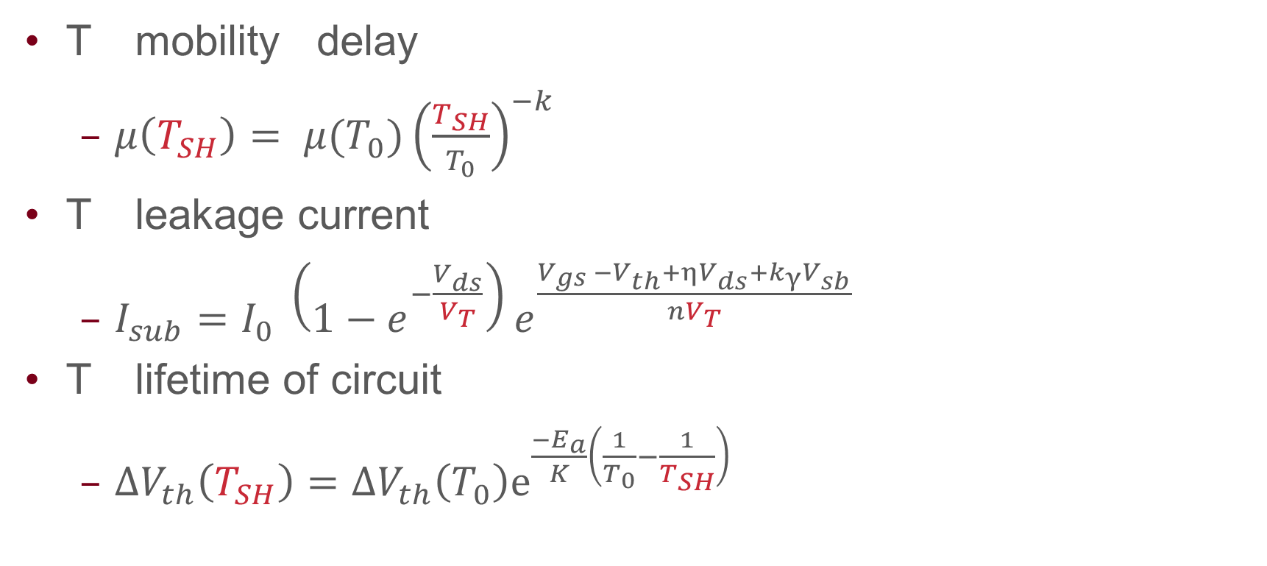
Effects of Self-heating (SH)
T mobility delay
  $μ\left(T_{SH}\right)= μ(T_{0}){\left(\frac{T_{SH}}{T_{0}}\right)}^{−k}$
T leakage current
  $I_{sub}=I_{0} \left(1−e^{−\frac{V_{ds}}{V_{T}}}\right)e^{\frac{V_{gs }−V_{th}+ηV_{ds}+k_{γ}V_{sb}}{nV_{T}}}$
T lifetime of circuit
  $ΔV_{th}\left(T_{SH}\right)=ΔV_{th}\left(T_{0}\right)ⅇ^{\frac{−E_{a}}{K}\left(\frac{1}{T_{0}}−\frac{1}{T_{SH}}\right)}$
4
Notes:
Cite the papers. Is it needed?

Slide 33
Parameters Used
7nm Bulk/SOI FinFET |  | 5nm lateral GAAFET
Fin width | 7nm | NW diameter | 6nm
Fin height | 32nm | NW horizontal spacing | 14nm
Fin pitch | 27nm | NW vertical spacing | 10.6nm
Gate length | 20nm | Gate length | 12nm
Gate pitch | 55nm | Gate pitch | 33nm
Oxide thickness | 1.8nm | Oxide thickness | 1nm
SOI BOX thickness | 140nm | SOI BOX thickness | 140nm
Substrate thickness | 1µm | Substrate thickness | 1µm
Contact width/length | 18nm | Contact width/length | 10nm
Gate to contact | 8nm | Gate to contact | 4nm
Material | Location | K (W/mK)
Si | Fins | 13
Si | Nanowires | 5
Si | Substrate | 148
Cu | Interconnect | 424
SiO2 | SOI BOX | 0.8
HfO2 | Gate dielectric | 0.27
Metal | Gate | 48

Slide 34
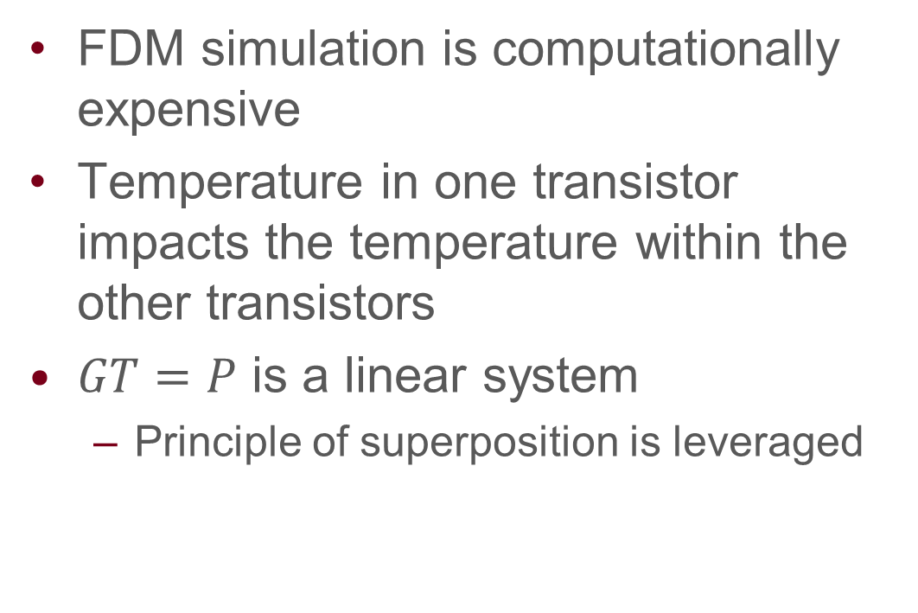
Look-up-table (LUT) Characterization
Local interconnect
Metal
FDM simulation is computationally expensive
Temperature in one transistor impacts the temperature within the other transistors
$GT=P$ is a linear system
  Principle of superposition is leveraged
$$I_{1}$$
$$I_{2}$$
$$I_{3}$$
$$I_{4}$$
Fin
Contact
Gate terminal
7

Slide 35
Circuit-level Impact on BTI and HCI
13

Slide 36
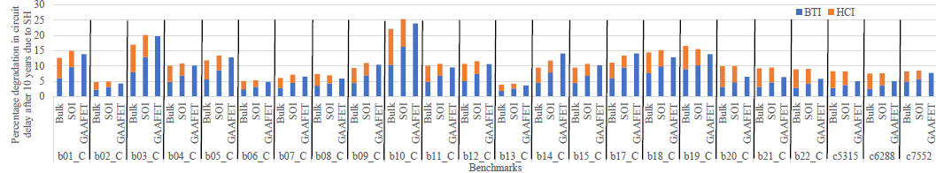
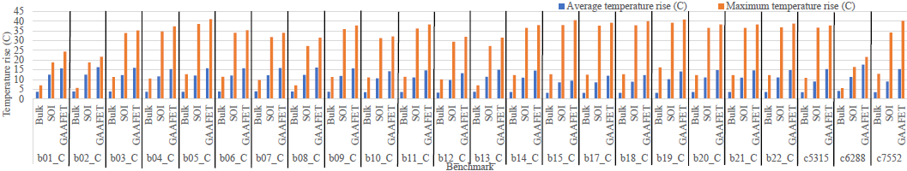
Circuit Level Analysis

Slide 37
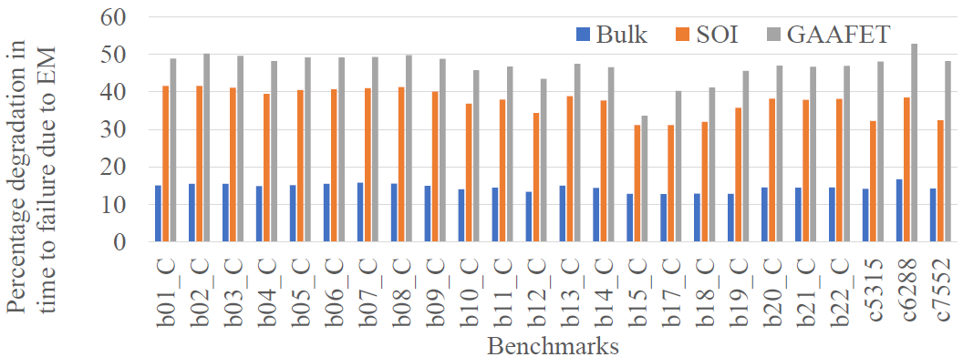
Impact of SH on Electromigration (EM)

